Slide 1
16. Greedy Algorithms

Slide 2
Outline
What is Greedy Algorithms?
An activity-selection problem
Elements of greedy strategy
Huffman codes
Review of the coin counting problem
Greedy vs. Dynamic Programming

Slide 3
Def.: Greedy Algorithms
Algorithms for optimization problems typically go through a sequence of steps, with a set of choices at each step.
Similar to Dynamic Programming!
A greedy algorithm always makes the choice that looks best at the moment. That is, it makes a locally optimal choice in the hope that this choice will lead to a globally optimal solution.
Greedy algorithms do not always yield optimal solutions

Slide 4
16.1 An Activity-Selection Problem
每個不曾起舞的日子都是對生命的辜負 – 尼采
No regret for our youth (青春不要留白大行動)
How to join as many activities as possible in a week?
Goal:
Joining as many activities as possible in a period
Assumption:
Finishing one then starting another (compatibility)
Can first have all activities sorted according to their finishing time

Slide 5
16.1 An A-S Problem (formulation)
Suppose we have a set S = {a₁, a₂, ..., a_{n}} of n proposed activities that with to use a resource. Each activity a_{i} has a start time s_{i} and a finish time f_{i} , where 0 ≤ s_{i} < f_{i} < ∞
If selected, activity a_{i} take place during the half-open time interval [s_{i}, f_{i}). Activities a_{i} and a_{j} are compatible if the intervals [s_{i}, f_{i}) and [s_{j}, f_{j}) do not overlap (i.e., a_{i} and a_{j} are compatible if s_{i} ≥ f_{j} or s_{j} ≥ f_{i})
[s₂, f₂)
[s₁, f₁)
[s₃, f₃)
time

Slide 6
16.1 An A-S Problem (example)
The activity-selection problem is to select a maximum-size subset of mutually compatible activities
Example:
i | 1 | 2 | 3 | 4 | 5 | 6 | 7 | 8 | 9 | 10 | 11
s_{i} | 1 | 3 | 0 | 5 | 3 | 5 | 6 | 8 | 8 | 2 | 12
f_{i} | 4 | 5 | 6 | 7 | 8 | 9 | 10 | 11 | 12 | 13 | 14

Slide 7
16.1 An A-S problem (solution)
We shall solve this problem in several steps. We start by formulating a dynamic programming solution to this program in which we combine optimal solutions to two subproblems to form an optimal solution to the original problem.
We shall then observe that we need only consider one choice – the greedy choice – and that when we make the greedy choice, then only one nonempty subproblem remains.

Slide 8
The Optimal Substructure of the A-S Problem
S_{ij} = {a_{k}∈S : f_{i} ≤ s_{k} < f_{k} ≤ s_{j}}, A_{ij} ⊆ S_{ij} the optimal set That is, S_{ij} is the subset of activities in S that can start after activity a_{i} finishes and finish before activity a_{j} starts
f₀ = 0 and s_{n+1} = ∞. Then S = S_{0,n+1}, and the ranges for i and j are given by 0 ≤ i, j ≤ n+1.
If we know a_{k} is included, then A_{ij} = A_{ik} ∪{a_{k}} ∪A_{kj}
a_{i} = [s_{i}, f_{i})
All possible activities go here!
a_{j} = [s_{j}, f_{j})
大問題答案拆開是小問題的答案!

Slide 9
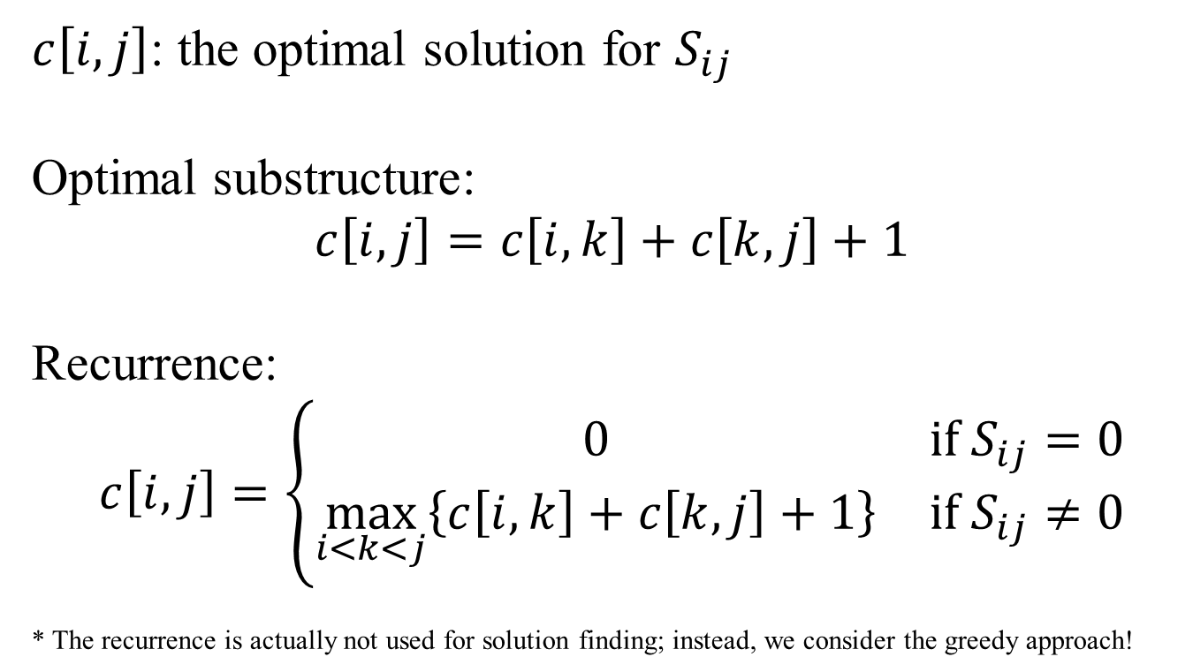
A Recursive Solution
$c\left[i,j\right]$: the optimal solution for $S_{ij}$
Optimal substructure:
$$c\left[i,j\right]=c\left[i,k\right]+c\left[k,j\right]+1$$
Recurrence:
$$c\left[i,j\right]=\left\{\begin{matrix}0 & {\text{if} S}_{ij}=0 \\ \max_{i<k<j}\left\{c\left[i,k\right]+c\left[k,j\right]+1\right\} & {\text{if} S}_{ij}≠0\end{matrix}\right.$$
* The recurrence is actually not used for solution finding; instead, we consider the greedy approach!

Slide 10
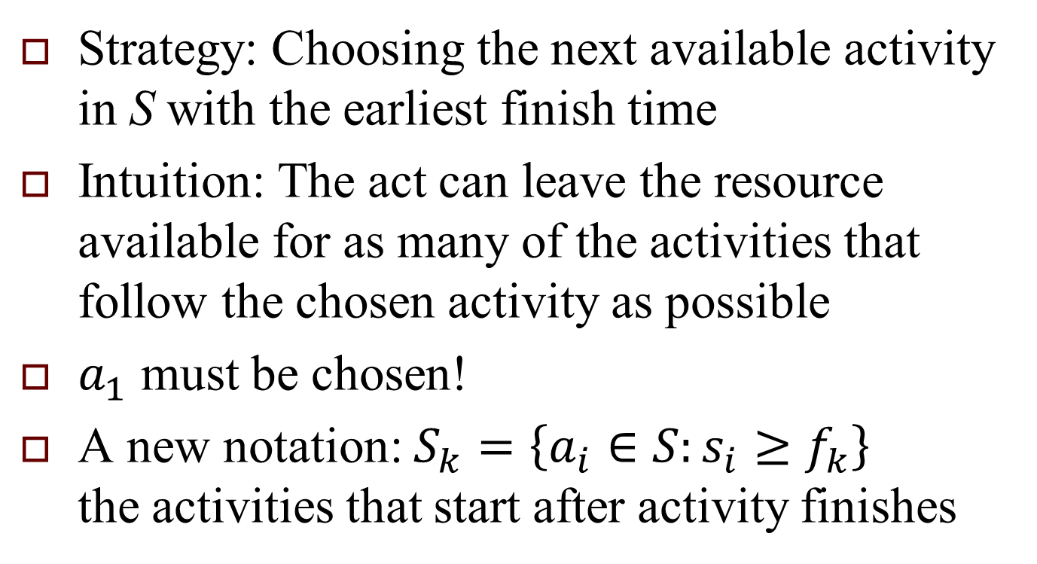
Making the Greedy Choice
Strategy: Choosing the next available activity in S with the earliest finish time
Intuition: The act can leave the resource available for as many of the activities that follow the chosen activity as possible
$a_{1}$ must be chosen!
A new notation: $S_{k}=\left\{a_{i}∈S:s_{i}≥f_{k}\right\}$ the activities that start after activity finishes

Slide 11
Converting a Dynamic-Programming Solution to a Greedy Solution
Theorem 16.1
Consider any nonempty subproblem S_{k}, and let a_{m} be the activity in S_{k} with the earliest finish time:
f_{m} = min { f_{j} : a_{j} ∈ S_{k}}.
then
1. Activity a_{m} is used in some maximum-size subset of mutually compatible activities of S_{k}.
2. Choosing a_{m} leaves the subproblem S_{m} as the only one that may be nonempty.

Slide 12
A Recursive Greedy Algorithm
RECURSIVE-ACTIVITY-SELECTOR(s, f, k, n)
1 m ← k +1
2 while m ≤ n and s[m] < f [k] Find the first activity in S_{k}
3 do m ← m + 1
4 if m ≤ n
5 return {a_{m}} ∪ RAS(s, f, m, n)
6 else return 0

Slide 13
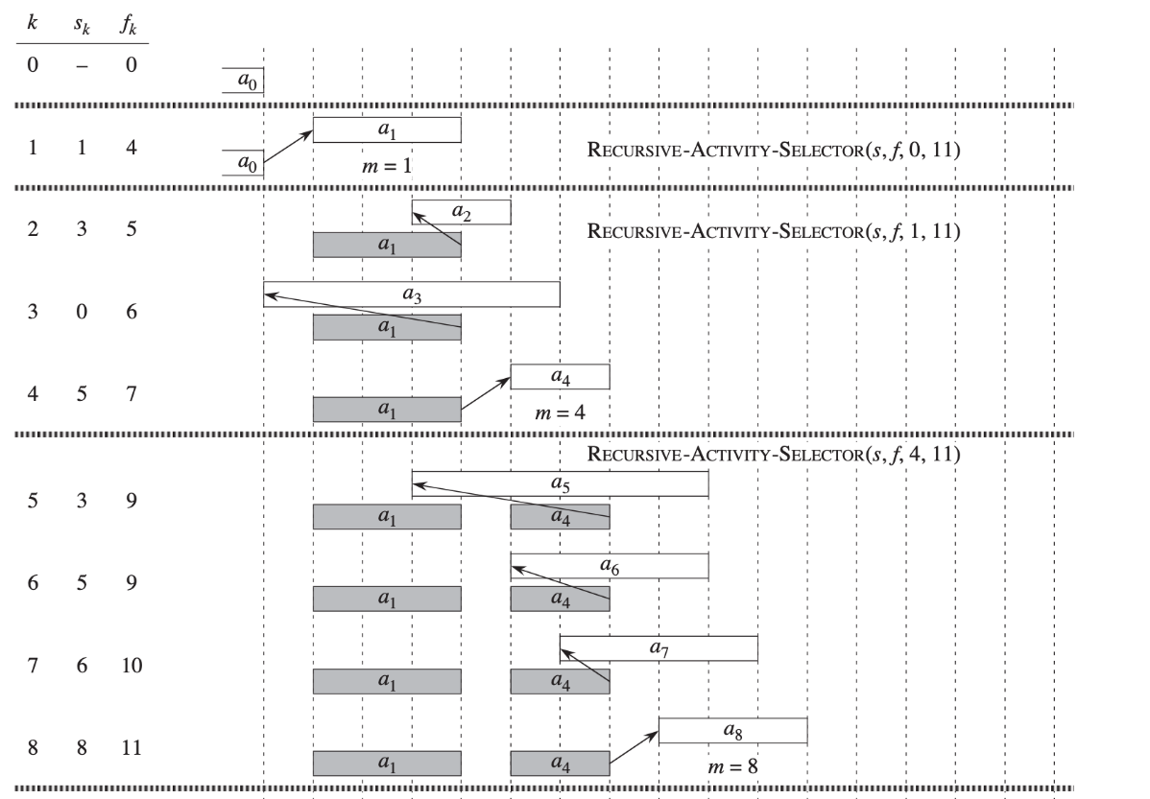
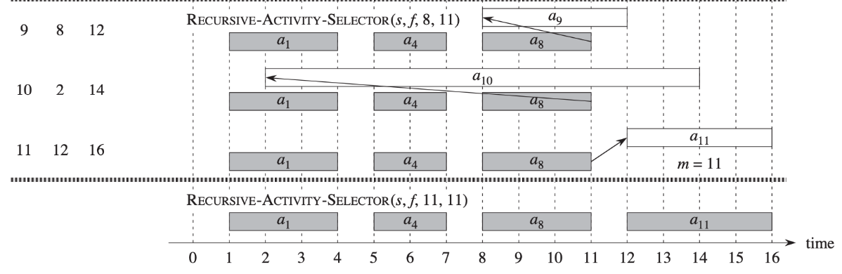
Greedy Algorithm on the Example
i | 1 | 2 | 3 | 4 | 5 | 6 | 7 | 8 | 9 | 10 | 11
s_{i} | 1 | 3 | 0 | 5 | 3 | 5 | 6 | 8 | 8 | 2 | 12
f_{i} | 4 | 5 | 6 | 7 | 8 | 9 | 10 | 11 | 12 | 13 | 14

Slide 14
An Iterative Greedy Algorithm
GREEDY-ACTIVITY-SELECTOR(s, f)
n ← length[s]
A ← {a₁}
k ← 1
for m ← 2 to n
do if s[m] ≥ f [k]
then A ← A ∪ {a_{m}}
k ← m
return A

Slide 15
16.2 Elements of the greedy strategy
Determine the optimal substructure of the problem.
Develop a recursive solution. (may bypass developing a recursive algorithm based on it if can be solved greedily)
Show that if we make the greedy choice, then only one subproblem remains.
Prove that it is always safe to make the greedy choice. (Steps 3 & 4 can occur in either order.)
Develop a recursive algorithm that implements the greedy strategy.
Convert the recursive algorithm to an iterative algorithm.

Slide 16
Designing a Greedy Algorithm
(simplified version than before)
Cast the optimization problem as one in which we make a choice and are left with one subproblem to solve.
Prove that there is always an optimal solution to the original problem that makes the greedy choice, so that the greedy choice is always safe.
Demonstrate that, having made the greedy choice , what remains is a subproblem with the property that if we combine an optimal solution to the subproblem with the greedy choice we have made, we arrive at an optimal solution to the original problem.

Slide 17
Two Ingredients for GA
Greedy-choice property: A globally optimal solution can be achieved by making locally optimal (greedy) choices.
In DP, the choice of each step depends on the solution to subproblems!
Optimal substructure: An optimal solution to the problem contains within it optimal solutions to subproblems.
Property that is needed for both DP & GA!

Slide 18
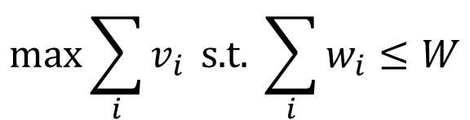
Knapsack Problems
0-1 knapsack problem
Fractional knapsack problem
$$\max_{}{\sum_{i}{v_{i}}} \text{s}\text{.}\text{t}\text{. }\sum_{i}{w_{i}}≤W$$

Slide 19
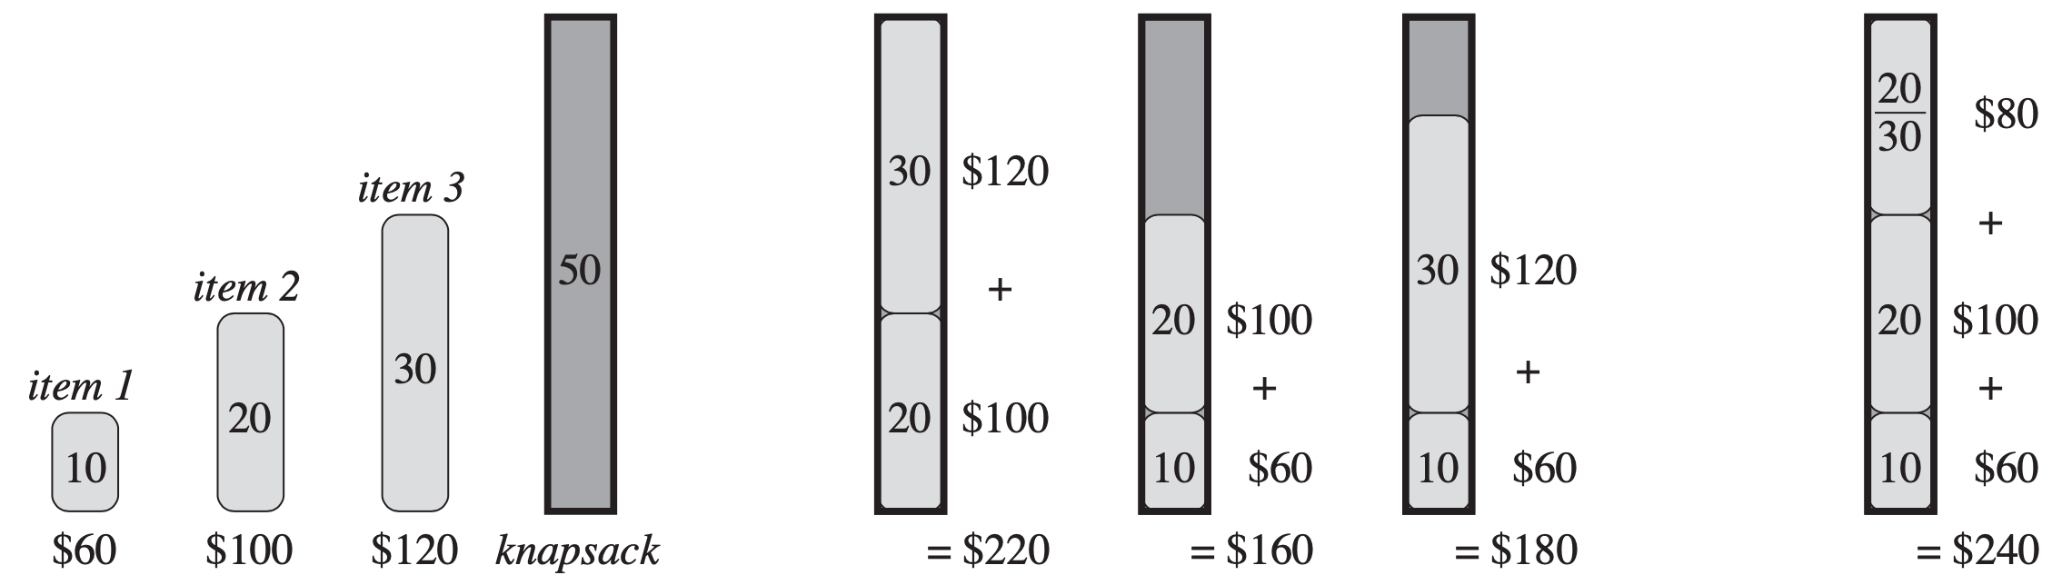
Greedy versus Dynamic Programming
Solving knapsack via greedy or others:
problem
0-1: Greedy not ok
Fractional: Greedy is ok

Slide 20
16.3 Huffman Codes
Def.: (1952, David A. Huffman) A variable-length code for lossless data compression
Optimal code: The codes has as shortest possible length
Prefix code: The codes in which no codeword is also a prefix of some other codeword (should be called “prefix-free” codes!)
A prefix code can always achieve the optimal code among any codes!

Slide 21
An Example
 | A | B | C | D | E | F
Frequency (in thousands) | 45 | 13 | 12 | 19 | 9 | 5
Fix-length codeword | 000 | 001 | 010 | 011 | 100 | 101
Variable-length codeword | 0 | 101 | 100 | 111 | 1101 | 1100

Slide 22
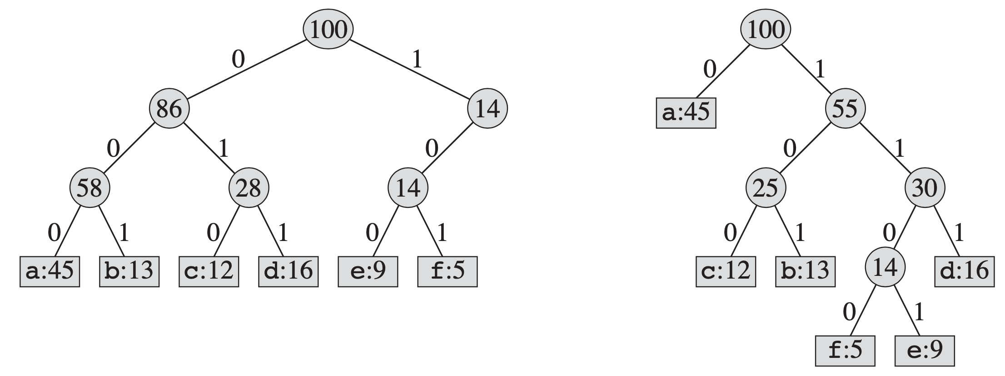
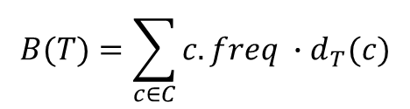
16.3 Huffman Codes (cont’d)
Prefix codes simplify decoding: the codeword that begins an encoded file is unambiguous!
Binary tree representation for coding schemes:
$$B(T)=\sum_{c∈C}{c.freq ∙d_{T}(c)}$$

Slide 23
Construction a Huffman Code
HUFFMAN( C )
1 n ← |C|
2 Q ← C
3 for i ← 1 to n – 1
4 do allocate a new node z
5 z.left ← x ← EXTRACT-MIN(Q)
6 z.right[z] ← y ← EXTRACT-MIN(Q)
7 z.freq ← x.freq + y.freq
8 INSERT(Q, z)
9 return EXTRACT-MIN(Q)
Complexity: O(n log n)

Slide 24
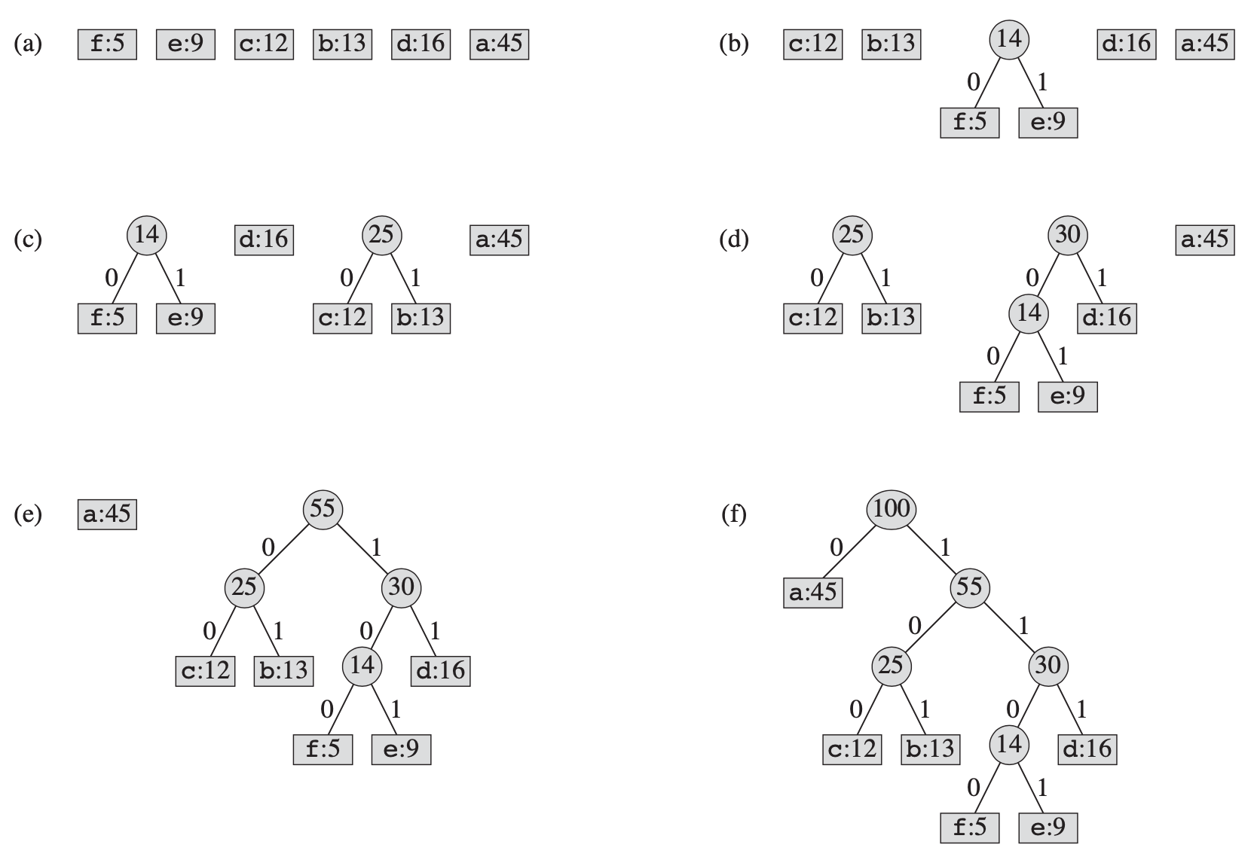
The Steps of Huffman’s Algorithm

Slide 25
Correctness of Huffman’s Algorithm
Lemma 16.2
Let C be an alphabet in which c ∈ C has frequency c.freq Let x and y be the two characters in C having the lowest frequencies. Then there exists an optimal prefix code in C in which the codeword for x and y having the same length and differ only in the last bit.

Slide 26
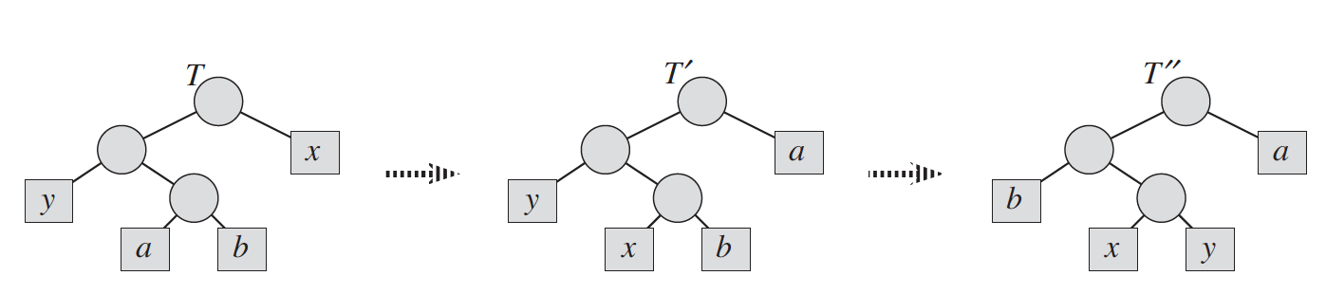
Proof of Lemma 16.2
Swapping leaves a and x produces tree T’, and then swapping leaves b and y produces tree T”.
Each swap does not increase the cost, and the resulting tree T” is also an optimal tree.

Slide 27
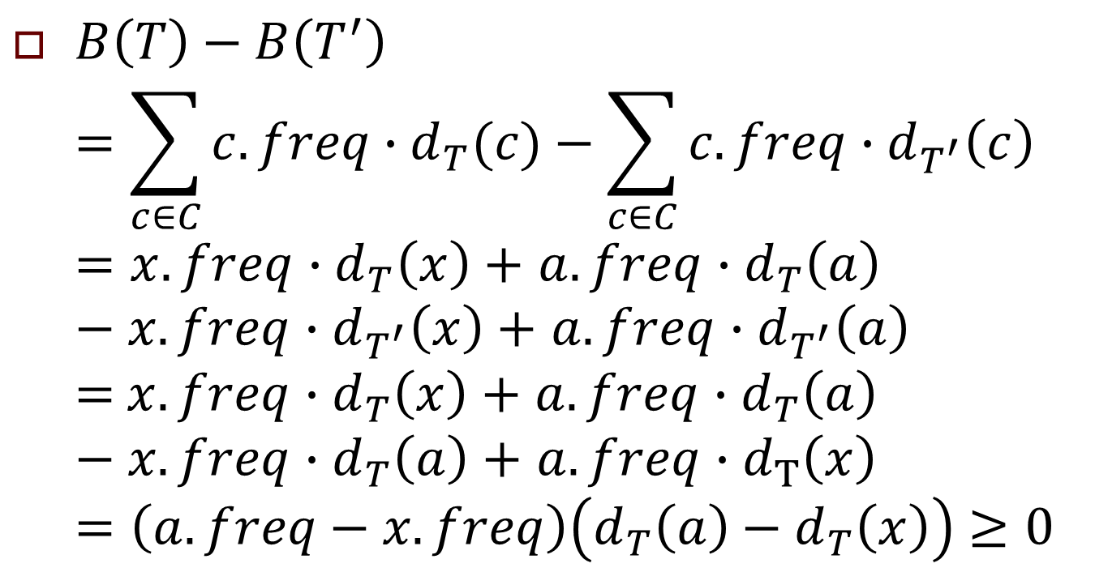
Proof of Lemma 16.2 (cont’d)
$B\left(T\right)−B\left(T^{′}\right)$ $=\sum_{c∈C}{c.freq∙d_{T}(c)}−\sum_{c∈C}{c.freq∙d_{T^{′}}\left(c\right)}$ $=x.freq$ $∙d_{T}\left(x\right)$ $+$ $a.freq$ $∙d_{T}\left(a\right)$ $−x.freq$ $∙d_{T^{′}}\left(x\right)$ $+$ $a.freq$ $∙d_{T^{′}}\left(a\right)$ = $x.freq$ $∙d_{T}\left(x\right)$ $+$ $a.freq$ $∙d_{T}\left(a\right)$ $−x.freq$ $∙d_{T}\left(a\right)$ $+$ $a.freq$ $∙d_{T}\left(x\right)$ $=\left(a.freq−x.freq\right)\left(d_{T}\left(a\right)−d_{T}\left(x\right)\right)$ $≥0$

Slide 28
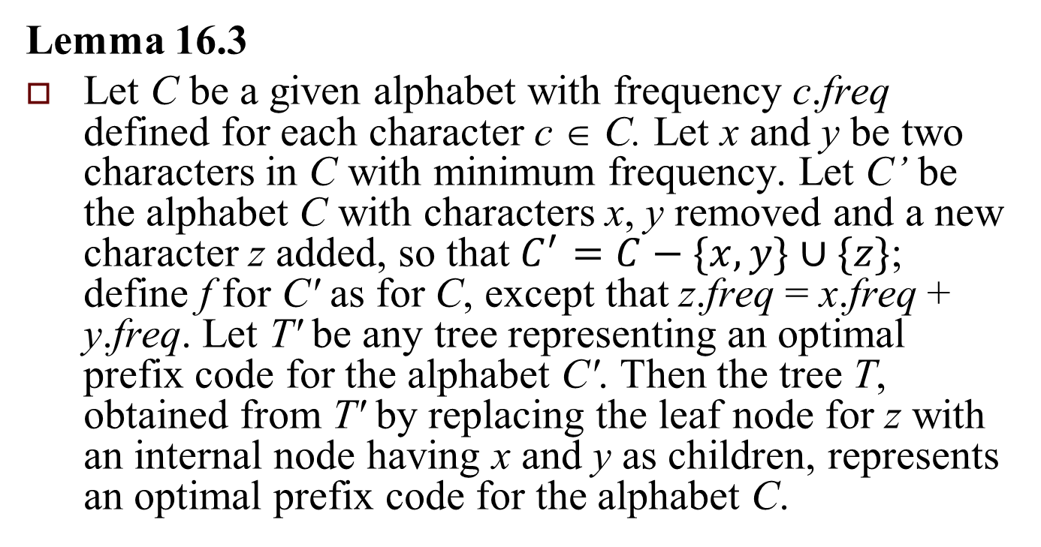
Correctness of Huffman’s Algorithm (cont’d)
Lemma 16.3
Let C be a given alphabet with frequency c.freq defined for each character c ∈ C. Let x and y be two characters in C with minimum frequency. Let C’ be the alphabet C with characters x, y removed and a new character z added, so that $C^{′}=C−\{x,y\}∪\{z\}$; define f for C' as for C, except that z.freq = x.freq + y.freq. Let T' be any tree representing an optimal prefix code for the alphabet C'. Then the tree T, obtained from T' by replacing the leaf node for z with an internal node having x and y as children, represents an optimal prefix code for the alphabet C.

Slide 29

Proof of Lemma 16.3
$x.freq$ $∙d_{T}\left(x\right)$ $+$ $y.freq$ $∙d_{T}\left(y\right)$ $=\left(x.freq+y.freq\right)\left(d_{T^{′}}\left(z\right)+1\right)$ $=z.freq∙d_{T^{′}}\left(z\right)+\left(x.freq+y.freq\right)$

Slide 30
Correctness of Huffman’s Algorithm
Theorem 16.4
Procedure HUFFMAN produces an optimal prefix code.

